Slide 1



DEPARTMENT OF ELECTRICAL AND ELECTRONICS ENGINEERING
EEB1233- DESIGN THINKING LABORATORY
AI POWERED SOLAR TRACKING SYSTEM FOR OPTIMAL ENERGY HARVESTING
PRESENTED BY:
INDHU SADASIVAM (927623BEE034)
ISWARYA.P (927622BEE035)
KARNIKA.D (927623BEE039)
KARUNYA SHREE .S (927622BEE042)
YEAR/ SEMESTER – II/IV
BATCH NUMBER : 14
DATE :06.06.2025

Slide 2
ABSTRACT
This project focuses on AI-powered solar tracking system designed to maximize energy harvesting by automatically adjusting the position of a solar panel based on sunlight intensity. Using light-dependent resistors (LDRs), the system detects the direction of maximum sunlight and rotates the panel using a servo motor. An Arduino microcontroller processes the sensor data, while a voltage sensor monitors power output. The system includes a battery for energy storage and a buck converter for stable power supply.It can further optimize tracking efficiency by learning sun movement patterns. This low-cost,30-40% energy-efficient setup and power of 1.6-7.6W is ideal for sustainable energy applications in both rural and urban areas.

Slide 3
EMPHATHY PHASE – UNDERSTANDING THE USER
Users include rural households, small-scale solar energy adopters, and schools or institutions using solar setups.
Interviews and surveys revealed that users struggle with inconsistent solar power, limited technical knowledge, and lack of affordable tracking systems.
A common need was for a low-cost, easy-to-use, self-adjusting solar solution that could improve efficiency without requiring manual intervention.
User Persona Example:
Ravi, a farmer in a remote village, relies on solar power for water pumps but loses efficiency due to static panel placement.

Slide 4
DEFINE PHASE – USER NEEDS & PROBLEM DEFINITION
User Needs:
Efficient solar energy collection
Affordable automation
Systems that work with minimal maintenance.
How Might We Statements:
How might we create a low-cost, automated solar tracking system to help users maximize energy output?
How might we ensure the system adapts to sunlight direction without user effort?

Slide 5
IDEATE PHASE – BRAINSTROMING SOLUTIONS
Ideas Generated:
Manual rotatable panels
AI-controlled panel tracking with LDRs
App-based solar angle notifier
Top Idea:
AI-integrated automatic solar tracker using Arduino and sensors.
Mind Map :
Central Idea: Smart Solar Tracking → Arduino → Sensors → Servo Motors →
Energy Monitoring→ User Display

Slide 6
PROPOSED IDEA/SOLUTION OVERVIEW
Description:
A smart system that uses Light Dependent Resistors (LDRs) to detect sunlight direction, then rotates the solar panel accordingly using servo motors controlled by an Arduino.
Features:
Automatic tracking of sunlight
Real-time voltage display
Battery-backed system
Compact and cost-effective
How it Solves the Problem:
Increases panel efficiency, requires no manual adjustment, and is affordable and scalable.

Slide 7
PROTOTYPE PHASE – BUILDING THE CONCEPT
Prototype Description:
This is a solar tracking system designed to enhance energy harvesting by aligning the solar panel to the direction of maximum sunlight using Light Dependent Resistors (LDRs) and a servo motor. An Arduino UNO acts as the central controller. The system senses the sunlight intensity using LDR sensors and accordingly rotates the solar panel via a servo motor for optimal alignment. Power management, voltage monitoring, and real-time display are integrated for efficiency.

Slide 8
PROTOTYPE PHASE – BUILDING THE CONCEPT
Arduino UNO (5V) : Microcontroller board that controls the entire system.
Servo Motor : Rotates the solar panel based on light direction.
LDR Sensor (5V) : Detects sunlight intensity to determine panel alignment.
Solar Panel (6V) : Converts sunlight into electrical energy.
Battery Pack (7.35V) : Stores energy to power the system when sunlight is low.

Slide 9
PROTOTYPE PHASE – BUILDING THE CONCEPT
Voltage Sensor (25V) : Measures voltage from the solar panel or battery.
LM7805 Voltage Regulator (10V to 5V) : Reduces voltage to a safe 5V for components.
DC-DC Buck Converter (25V to 5V) : Converts high or variable DC voltage to stable 5V.
LCD Display (5V) with I2C : Shows real-time data like voltage and light levels.
ON/OFF : Switch turns the system on or off manually.

Slide 10
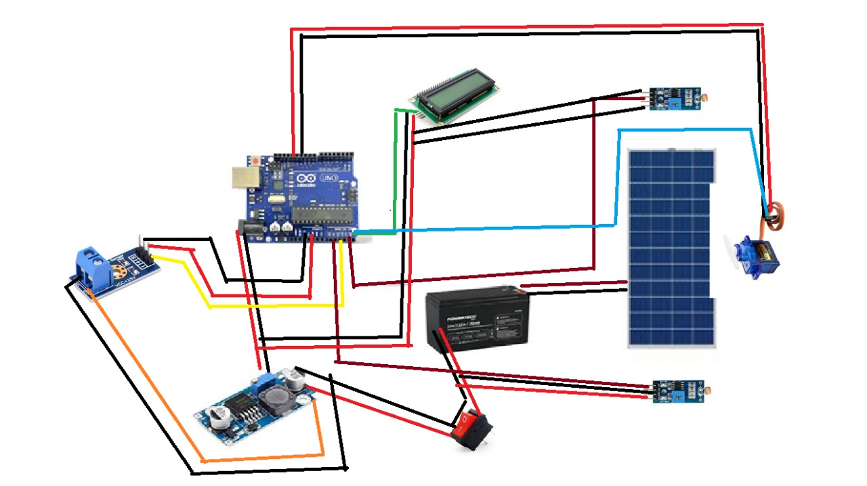
CIRCUIT DIAGRAM

Slide 11
WORKING
This AI-powered solar tracking system automatically rotates the solar panel to face the direction of maximum sunlight. It uses LDR sensors to detect light intensity from different directions. The Arduino Uno processes this data and controls a servo motor to adjust the panel’s position. A solar panel generates power and charges a 7.35V battery. A voltage sensor monitors power levels, and a DC-DC converter regulates the voltage to 5V for the components. An LCD with an I2C module displays real-time information. This smart system increases energy efficiency by keeping the solar panel aligned with the sun throughout the day.

Slide 12
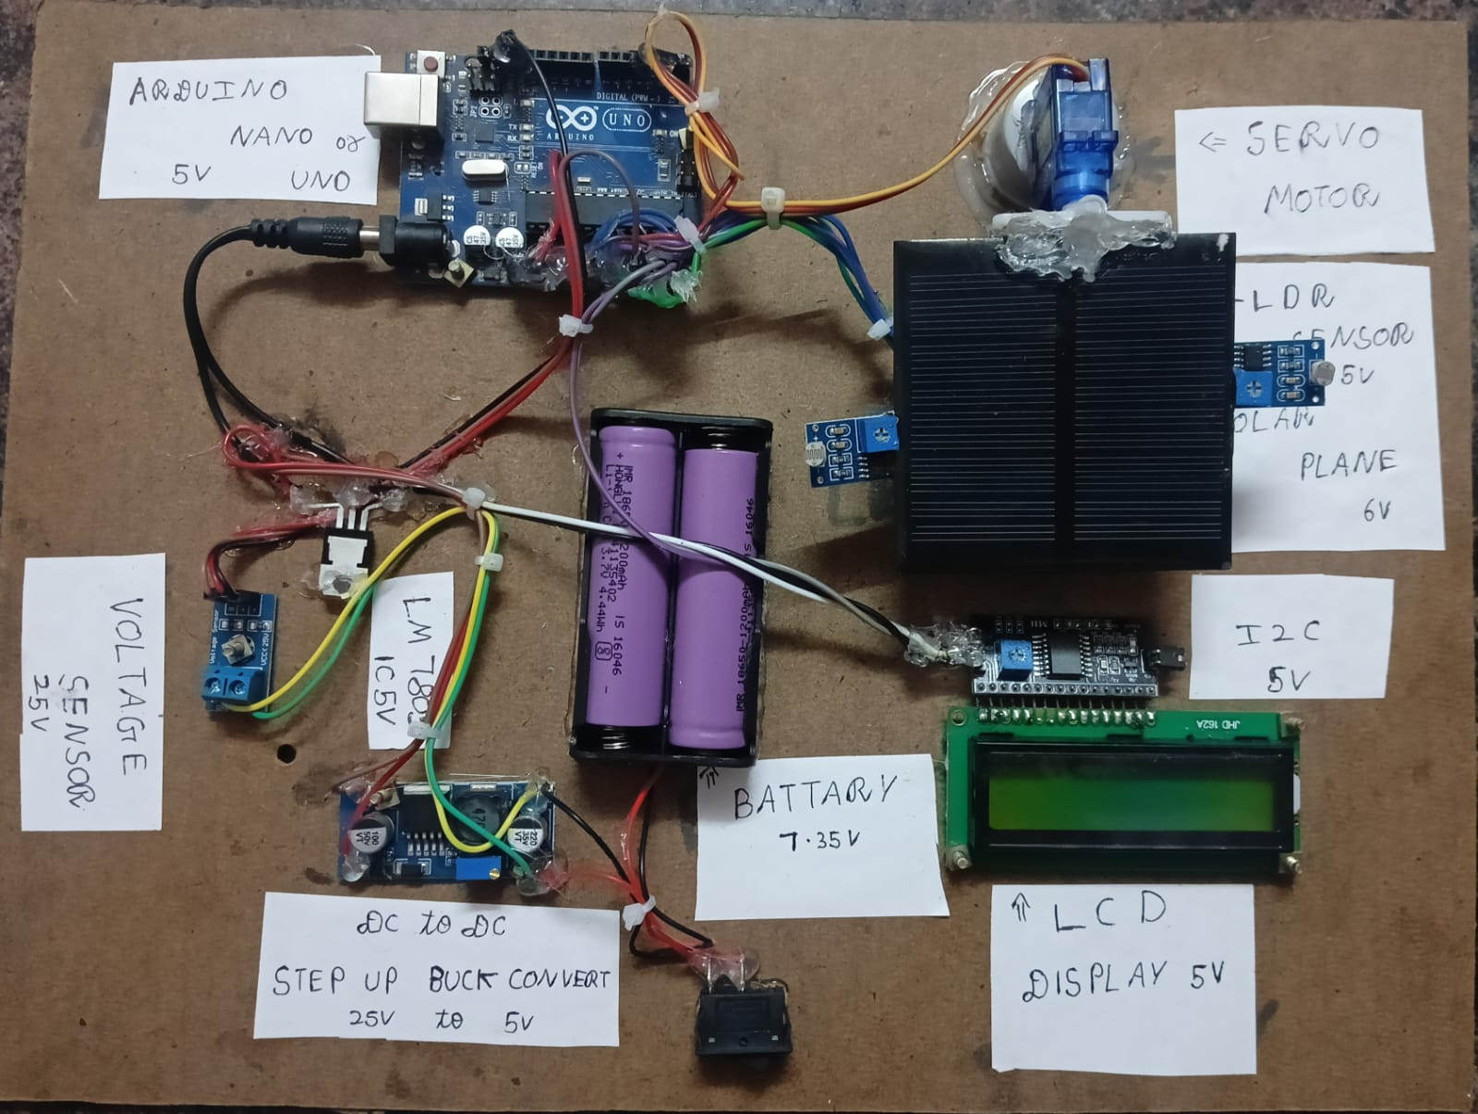
HARDWARE PHOTO

Slide 13
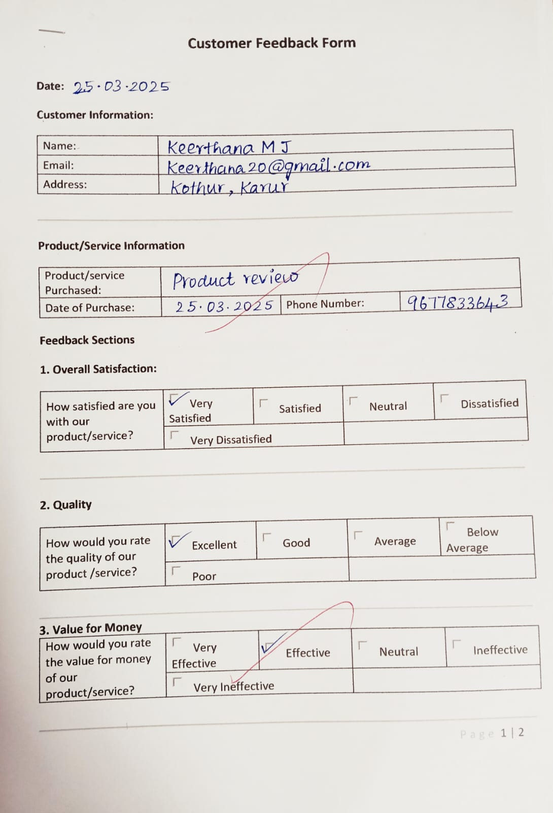
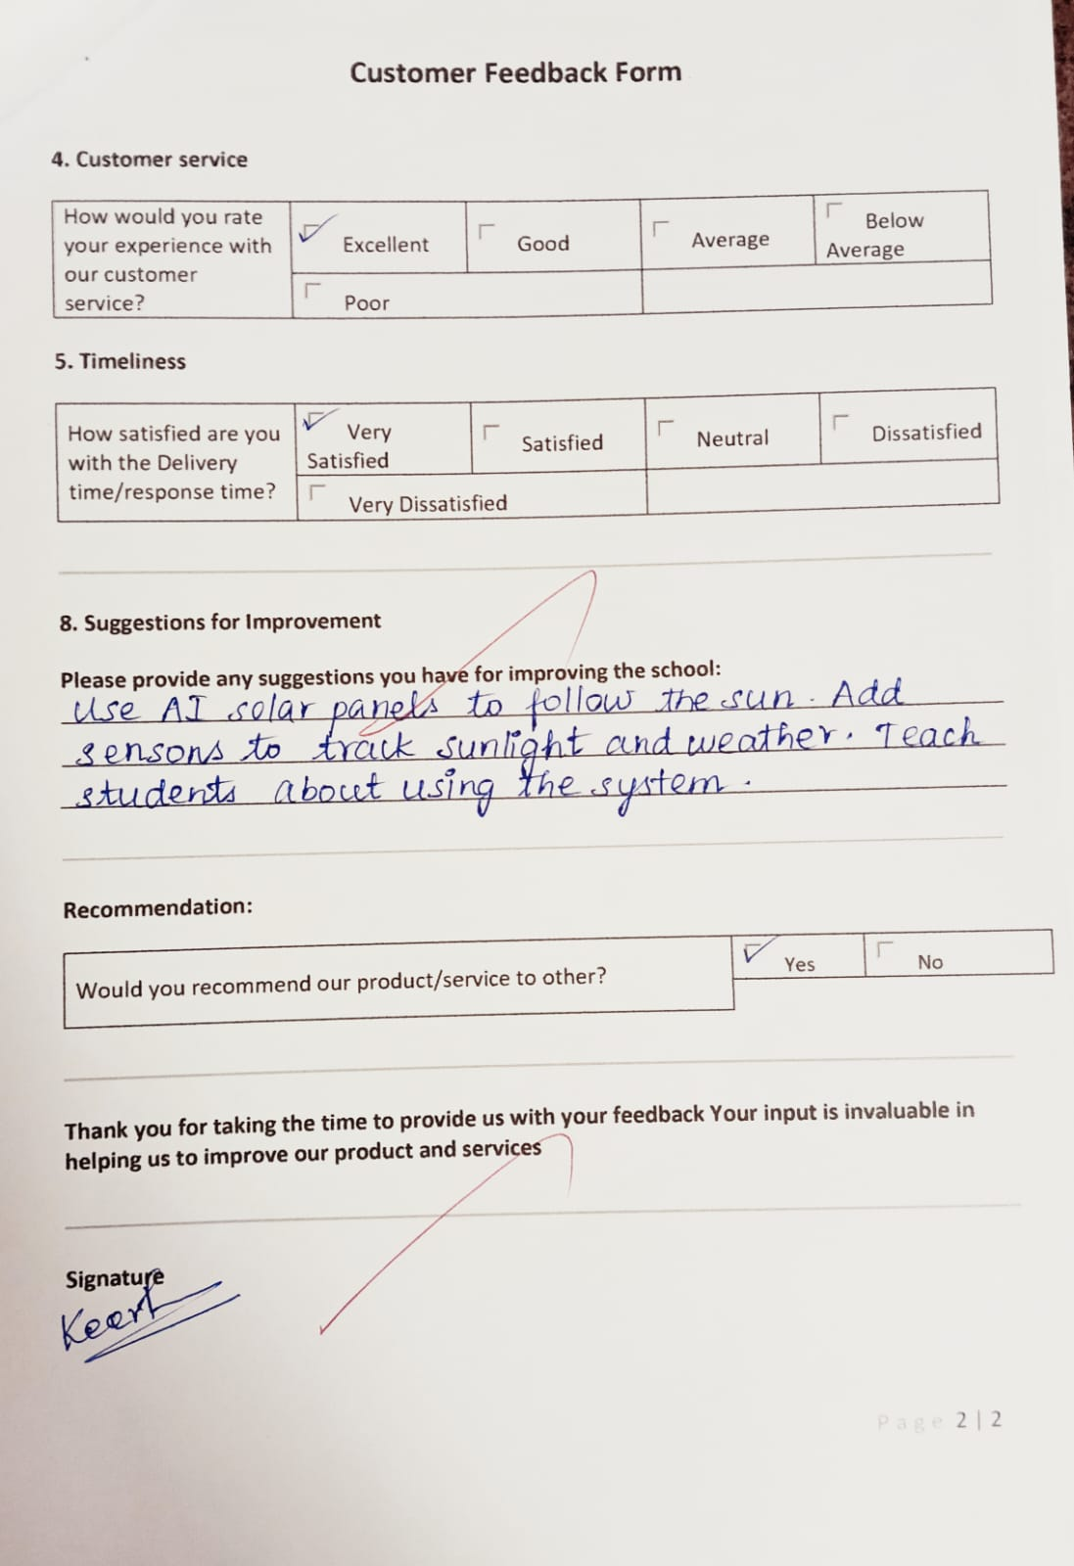
TEST PHASE – USER FEEDBACK

Slide 14
FINAL SOLUTION AND VALUE PROPOSITION
Refined Design:
Compact AI-enabled solar tracking with user display and efficient voltage monitoring
How it meets User Needs:
Automatic sunlight alignment
User-friendly interface
Durable and scalable
Unique Value:
Combines affordability with advanced functionality
Ideal for educational, rural, and renewable energy applications

Slide 15
IMPLEMENTATION PLAN
Planning & Component Collection
– Identify the problem and decide project features
– Design the circuit and gather all required components (Arduino, LDRs, servo, etc.)
Prototype Development
– Connect components and build the system
– Write Arduino code for tracking and voltage display and test basic panel movement using LDR and servo motor
AI Integration & Testing
– Test the system under sunlight and collect feedback for improvement

Slide 16
IMPACT & BENEFITS
Impact on Users:
30–40% more energy harnessed
Reduced manual work
Hands-on STEM learning for students
Broader Benefits:
Supports renewable energy movement
Promotes innovation in low-resource settings
Educates the next generation on sustainable tech

Slide 17
CHALLENGES AND LEARNING
Key Challenges:
Calibration of LDRs
Powering the motor efficiently
Getting accurate voltage reading
Lessons Learned:
Importance of iterative prototyping
User feedback is crucial for refinement
Real-world implementation differs from theory

Slide 18
CONCLUSION
This project successfully addresses the problem of inefficient solar energy usage through a practical and smart solution. By using real-time sunlight tracking and incorporating AI potential, it ensures optimized solar energy harvesting. It offers great value in energy sustainability, user accessibility, and long-term cost-effectiveness. The system is scalable, energy-efficient, and adaptable for both rural and urban settings. With further development, it has the potential to contribute significantly to clean energy adoption and environmental impact reduction.

Slide 19
FUTURE ENHANCEMENT
Integration of IoT (Internet of Things)
- Enable remote monitoring of solar output and system status via mobile apps or cloud dashboards.
AI-Based Predictive Tracking
- Use machine learning to predict sun movement based on location, time, and weather data for proactive panel adjustment.
Self-Cleaning Mechanism
- Add an automated cleaning system to remove dust or debris from the panel surface to maintain optimal performance.

Slide 20
REFERENCE
[1] A. Singh and R. Gupta, “Automatic solar tracking system using Arduino,” in 2021 Int. Conf. on Sustainable Energy and Future Electric Transportation (SEFET), 2021, pp. 1–5.
[2] M. B. Gholam and A. T. Rashid, “AI-based solar tracking for energy efficiency,” in 2020 IEEE Int. Conf. on Smart Energy Grid Engineering (SEGE), 2020, pp. 58–63.
[3] A. A. Osunlola et al., “Dual-axis solar tracker using microcontroller,” in 2019 IEEE PES/IAS PowerAfrica, 2019, pp. 585–589.

